Slide 1
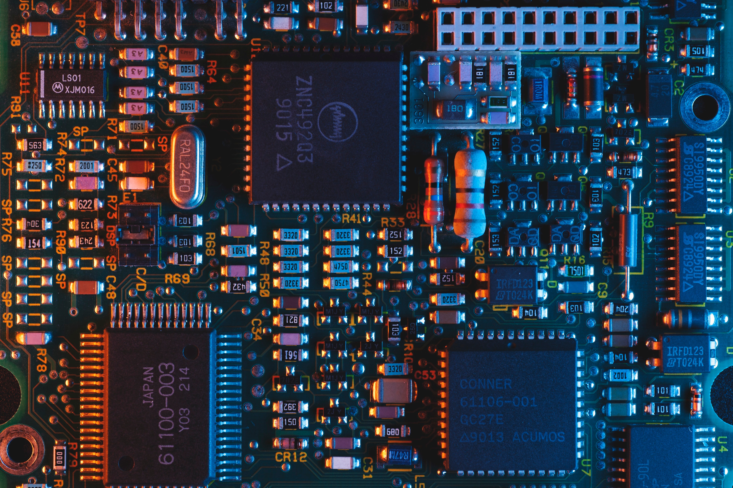
Estimating cost of a floorplan

Slide 2
Topics will be discussed –
Introduction
Objective
Cost Function
Computation

Slide 3
INTRODUCTION
Cost of floorplanning :
The number of feasible solutions of a floorplanning
Measure the quality of floorplans

Slide 4
OBJECTIVE
Finding the best solution with minimized cost
for floorplanning
to optimize the performance of the circuits

Slide 5
Cost function
Two most commonly used cost criteria –
Minimizing Area
Minimizing total Wirelength

Slide 6

Cost function

Slide 7
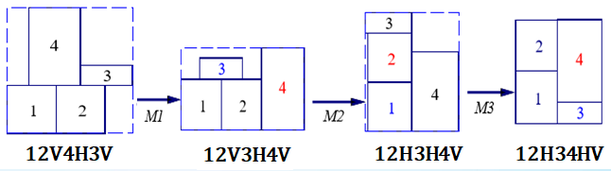
COMPUTING AREA
A ( the minimized area with zero dead space ) : 12H34HV

Slide 8
COMPUTING AREA
Step 1 : Constructing the corresponding skewed slicing tree
V
H H
1 2
H 5
3 4
Normalized
Polish
Expression
12H34H5HV

Slide 9
COMPUTING AREA
Step 2 : Placing the dimensions of the modules
from given information
height
Dimensions of the modules
Module No. | Width ( w ) | Height ( h )
1 | 4 | 6
2 | 4 | 4
3 | 3 | 4
4 | 4 | 4
5 | 3 | 4
width
Dimension of a module : ( w , h )

Slide 10
COMPUTING AREA
Step 2 : Placing the dimensions of the modules
from given information
Height ( 6 )
One thing to notice –
Module rotation is allowed
Two types implementation
( a )
For example :
( a ) from given table –
Dimension of module 1 : ( 4 , 6 )
Width ( 4 )
Height ( 4 )
( b ) by rotating –
Dimension of module 1 : ( 6 , 4 )
( width = height = 6 ; height = width = 4 )
( b )
Width ( 6 )

Slide 11
COMPUTING AREA
Step 2 : Placing the dimensions of the modules
V
H H
1 2
H 5
3 4
1
2
5
( 4 , 6 )
( 4 , 4 )
( 3 , 4 )
1
(6 , 4 )
3
( 4 , 3 )
5
4
( 3 , 4 )
( 4 , 4 )
3
( 4 , 3 )

Slide 12
COMPUTING AREA
Step 3 : Computing dimension based on the slicing tree
Let , left module = 1 , right module = 2
For HORIZONTAL cut :
Dimension of a module = ( max ( w1 , w2 ) , h1+h2 )
For VERTICAL cut :
Dimension of a module = ( w1+w2 , max ( h1 , h2 ) )

Slide 13
COMPUTING AREA
H = ( max ( w1 , w2 ) , h1+h2 )
34H
(1) Dimension of module 3 :
w1 = 3 , h1 = 4
Dimension of module 4 :
w2 = 4 , h2 = 4
 Dimension1 of module 34H :
( 4 , 8 )
Step 3 : computing dimensions
V
H H
1 2
H 5
3 4
4
3
( 4 , 6 )
( 4 , 4 )
( 3 , 4 )
(6 , 4 )
( 4 , 3 )
( 3 , 4 )
( 4 , 4 )
( 4 , 3 )

Slide 14
COMPUTING AREA
H = ( max ( w1 , w2 ) , h1+h2 )
34H
(2) Dimension of module 3 :
w1 = 4 , h1 = 3
Dimension of module 4 :
w2 = 4 , h2 = 4
 Dimension2 of module 34H :
( 4 , 7 )
Step 3 : computing dimensions
V
H H
1 2
H 5
3 4
4
3
( 4 , 6 )
( 4 , 4 )
( 3 , 4 )
(6 , 4 )
( 4 , 3 )
( 3 , 4 )
( 4 , 4 )
( 4 , 3 )

Slide 15
COMPUTING AREA
H = ( max ( w1 , w2 ) , h1+h2 )
34H5H
(1) Dimension of module 34H :
w1 = 4 , h1 = 7
Dimension of module 4 :
w2 = 3 , h2 = 4
Dimension1 of
module 34H5H : ( 4 , 11 )
Step 3 : computing dimensions
V
H H
1 2
H 5
3 4
5
4
3
( 4 , 6 )
( 4 , 4 )
( 4 , 7 )
( 3 , 4 )
(6 , 4 )
( 4 , 3 )
( 3 , 4 )
( 4 , 4 )
( 4 , 3 )

Slide 16
COMPUTING AREA
H = ( max ( w1 , w2 ) , h1+h2 )
34H5H
(2) Dimension of module 3 :
w1 = 4 , h1 = 7
Dimension of module 4 :
w2 = 4 , h2 = 3
Dimension2 of
module 34H5H : ( 4 , 10 )
Step 3 : computing dimensions
V
H H
1 2
H 5
3 4
5
4
3
( 4 , 6 )
( 4 , 4 )
( 4 , 7 )
( 3 , 4 )
(6 , 4 )
( 4 , 3 )
( 3 , 4 )
( 4 , 4 )
( 4 , 3 )

Slide 17
COMPUTING AREA
Step 3 : computing dimensions
V
H H
1 2
H 5
3 4
H = ( max ( w1 , w2 ) , h1+h2 )
12H
(1) Dimension of module 1 :
w1 = 4 , h1 = 6
Dimension of module 2 :
w2 = 4 , h2 = 4
Dimension1 of
module 12H : ( 4 , 10 )
( 4 , 10 )
2
1
( 4 , 6 )
( 4 , 4 )
( 4 , 7 )
( 3 , 4 )
(6 , 4 )
( 4 , 3 )
( 3 , 4 )
( 4 , 4 )
( 4 , 3 )

Slide 18
COMPUTING AREA
Step 3 : computing dimensions
V
H H
1 2
H 5
3 4
H = ( max ( w1 , w2 ) , h1+h2 )
12H
(2) Dimension of module 1 :
w1 = 6 , h1 = 4
Dimension of module 2 :
w2 = 4 , h2 = 4
Dimension1 of
module 12H : ( 6 , 8 )
( 4 , 10 )
2
( 4 , 6 )
( 4 , 4 )
1
( 4 , 7 )
( 3 , 4 )
(6 , 4 )
( 4 , 3 )
( 3 , 4 )
( 4 , 4 )
( 4 , 3 )

Slide 19
COMPUTING AREA
Step 3 : computing dimensions
V
H H
1 2
H 5
3 4
( 4 , 10 )
( 6 , 8 )
( 4 , 10 )
V = (w1+w2 , max ( h1 , h2 ) )
12H34H5HV
(1) Dimension of module 12H :
w1 = 4 , h1 = 10
Dimension of module 34H5H :
w2 = 4 , h2 = 10
Dimension1 of module
12H : ( 8 , 10)
( 4 , 6 )
( 4 , 4 )
2
5
( 4 , 7 )
( 3 , 4 )
(6 , 4 )
( 4 , 3 )
1
4
( 3 , 4 )
( 4 , 4 )
3
( 4 , 3 )

Slide 20
COMPUTING AREA
Step 3 : computing dimensions
V
H H
1 2
H 5
3 4
( 8 , 10 )
( 4 , 10 )
( 6 , 8 )
( 4 , 10 )
V = (w1+w2 , max ( h1 , h2 ) )
12H34H5HV
(1) Dimension of module 12H :
w1 = 6 , h1 = 8
Dimension of module 34H5H :
w2 = 4 , h2 = 10
Dimension1 of module
12H : ( 10 , 10)
( 4 , 6 )
( 4 , 4 )
5
( 4 , 7 )
( 3 , 4 )
(6 , 4 )
2
4
( 4 , 3 )
1
3
( 3 , 4 )
( 4 , 4 )
( 4 , 3 )

Slide 21
COMPUTING AREA
Step 3 : computing dimensions
V
H H
1 2
H 5
3 4
( 8 , 10 )
Width = 8 ; Height = 10
 Area = 8 x 10 = 80 unit
( 4 , 10 )
( 6 , 8 )
( 4 , 10 )
( 4 , 6 )
( 4 , 4 )
( 4 , 7 )
( 3 , 4 )
(6 , 4 )
( 4 , 3 )
( 3 , 4 )
( 4 , 4 )
( 4 , 3 )

Slide 22
COMPUTING wirelength
Only go through approximation
Actual wiring is not performed at the
floorplan stage
HPWL : Popular approximation measurement
Half-perimeter wirelength
The half-perimeter length of the smallest bounding box that encloses all pins or the
Can be computed by use of the centers of modules

Slide 23
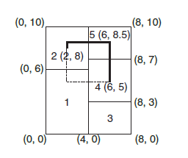
COMPUTING wirelength
HPWL of a net connecting modules 2 , 4 and 5 :
Height = 3.5 ; width = 4
HPWL = 3.5 + 4 = 7.5

